Slide 1
Biology of the Mind

Slide 2
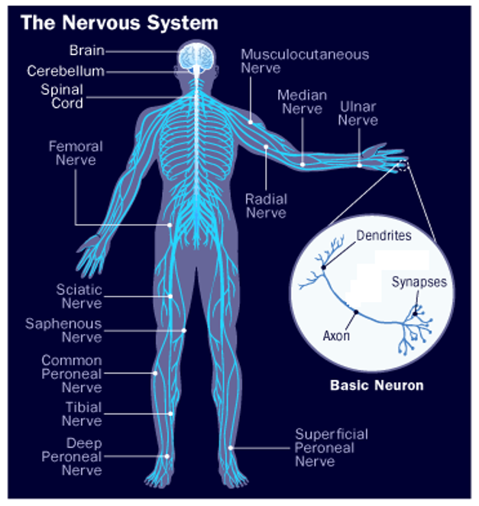

Slide 3
NERVOUS SYSTEM
Central Nervous System
The body’s decision maker.
Directs basic life processes and higher-level mental processes.
Peripheral Nervous System
Responsible for gathering sensory information to send to CNS.
Transmits CNS decisions to other body parts.
Brain
Directs activity, processes information, maintains life support.
Spinal Cord
Column of nerves between the brain and peripheral nervous system.
Receives sensory input, sends info to the brain, responds with motor output.
Somatic Nervous System
Carries sensory information to the spinal cord and relays motor commands.
Controls voluntary movements.
Autonomic Nervous System
Regulates involuntary bodily processes (e.g. heart rate, respiration).
Operates automatically without conscious direction.
Sympathetic Nervous System
Arouses and expends energy.
Fight or flight responses.
Parasympathetic Nervous System
Calms and conserves energy.

Slide 4
Nervous System
Neurons
Nerve cells found throughout nervous system.
Specialize in electrical and chemical communication.
Sensory: send information to the brain.
Motor: send information from the CNS.
Interneurons: does the work between the sensory input and the motor output.
Neurotransmitters
Chemical messengers released across synaptic gaps of neurons.
“Caught” by receptor proteins to bind onto neighboring neurons.

Slide 5
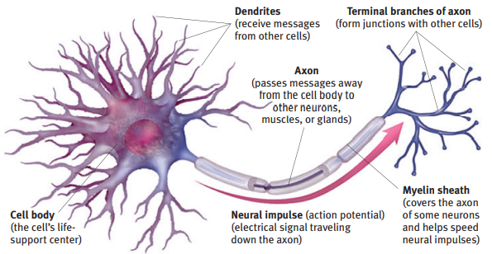

Slide 6
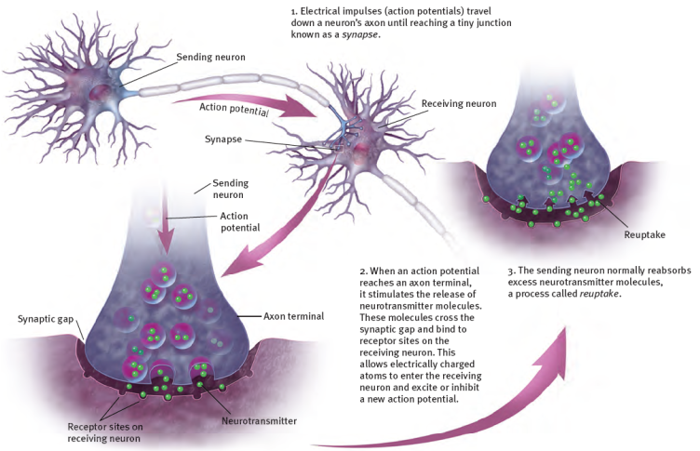

Slide 7
10% of the Brain Myth
If this were true, you could lose 90% of your brain and be unaffected.
Different areas of the brain serve different functions.
Certain parts of the brain are more active depending on the task that is being performed.
Metaphor of physical activity.
Damage to different areas of the brain are associated with different consequences.

Slide 8
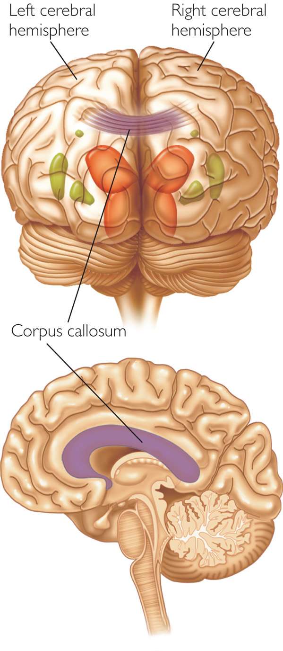
Divided Brain
Hemispheric specialization
Each hemisphere controls the opposite side of the body.
Right hemisphere: spatial and visual functions, attention, memory.
Left hemisphere: speaking, language, math, abstract thinking.
Corpus callosum: bundle of nerve fibers that connects and allows communication between the two hemispheres of the cerebrum.
https://www.youtube.com/watch?v=lfGwsAdS9Dc&t=462s

Slide 9
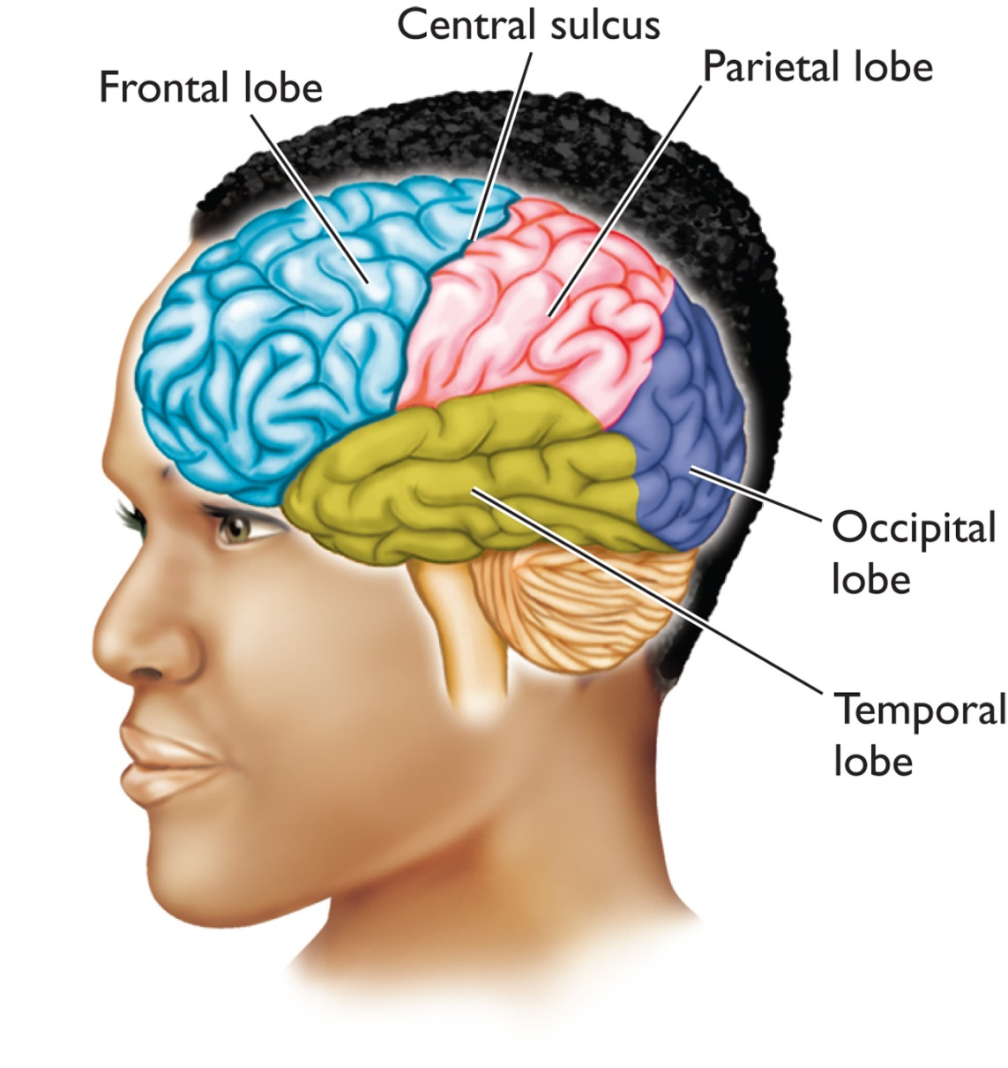
Cerebral Cortex
Cerebral cortex: outermost layer of the brain.
Analyzes sensory info, performs complex brain functions (e.g. reasoning, language).
Frontal Lobe
Attention, planning, abstract thinking.
Occipital Lobe
Vision
Temporal Lobe
Hearing & language
Parietal Lobe
Touch & perception

Slide 10
Frontal Lobe
Phineas Gage: damage to left frontal lobe.
https://www.youtube.com/watch?v=FCzLEd70n54
Prefrontal cortex: the part of the frontal lobe that is responsible for thinking, executive control, planning, mood, personality, self-awareness.
Executive functioning: overseeing & organizing most other brain functions.
Decision making & impulse control.
Generally, people who are easily distracted and/or make impulsive decisions have weak responses in the prefrontal cortex.

Slide 11
Pre-Frontal Cortex
Broca’s area: language area in prefrontal cortex that controls speech production.
Common problems if damaged:
Comprehension intact, but loss of ability to produce language.
Long pauses between words.
Only including most relevant words.
May not be able to produce many words.
Broca’s Aphasia/ expressive aphasia:
https://www.youtube.com/watch?v=1aplTvEQ6ew

Slide 12
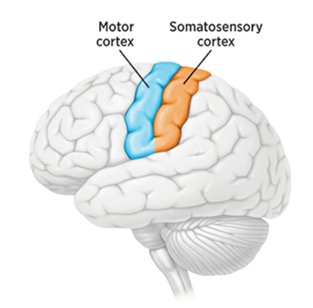
Parietal Lobe
Part of cerebral cortex that is specialized for sensory perception, processing, and integrating sensory information for a holistic understanding of our environment.
Somatosensory cortex: receives information from the senses.
Sensitive to touch (e.g. pressure, pain) and temperature.
Relays touch information to motor cortex.
Damage to parietal lobe can lead to visual neglect:
https://www.youtube.com/watch?v=ymKvS0XsM4w

Slide 13
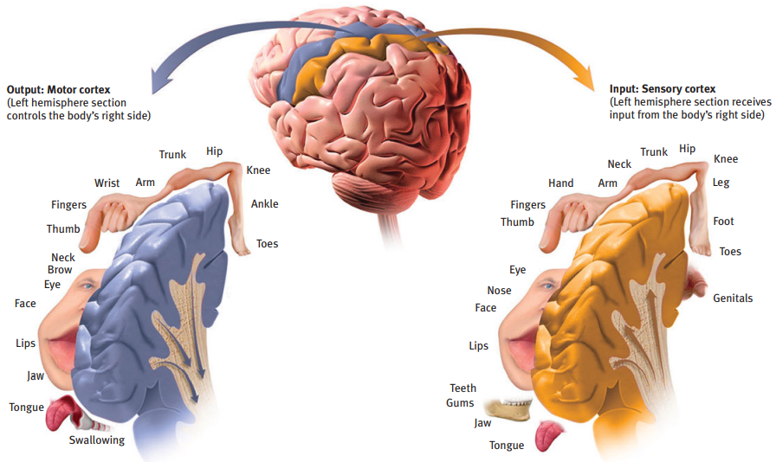

Slide 14
Occipital & Temporal Lobes
Occipital: visual perception, color, form, motion.
Visual Agnosia (youtube.com)
Temporal: hearing, understanding language, memory.
Stores memories of autobiographical events.
Wernicke’s Area: aids in understanding speech.
Wernicke’s aphasia/ fluent aphasia
https://www.youtube.com/watch?v=3oef68YabD0

Slide 15
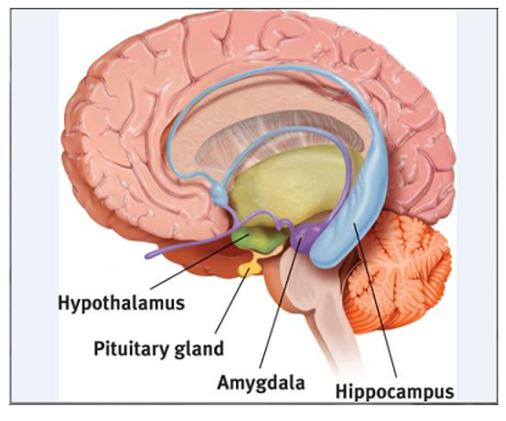
Limbic System
Limbic system: area of brain that involves emotion and motivation.
Hypothalamus
Regulates autonomic system & pituitary gland (e.g. hunger, thirst, body temperature, fight or flight responses).
Governs the endocrine system via pituitary gland.

Slide 16
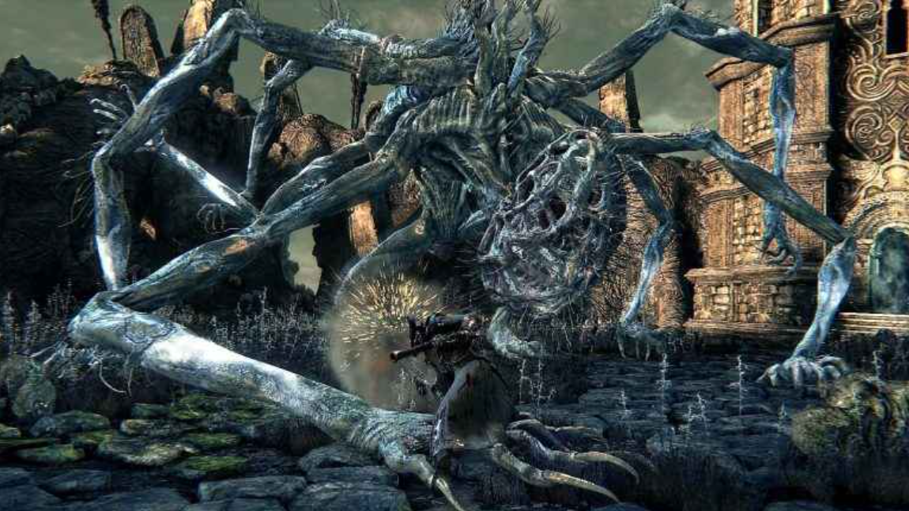
Limbic System
Amygdala
Fear center of the brain.
Responsible for emotional processes.
Attaches emotional significance to emotional events (e.g. anger, fear).
People with highly reactive amygdalas will have stronger startle response and habituate more slowly (manifest more anxiety).

Slide 17

Limbic System
Hippocampus
Primary function is memory.
Spatial memory.
Helps create new memories by bringing short term memories into long term memory.

Slide 18
Endocrine System
Collection of glands throughout the body that secrete hormones directly into bloodstream.
Pituitary gland: the master gland that influences the release of hormones by other glands.
Hormones are also messengers that carry signals throughout the body and trigger physiological arousal.
Similar effect as neurotransmitters, but slower to travel to the receptor and produces a longer lasting effect (e.g. adrenaline).
Endocrine system “broadcasts” via bloodstream vs. neurotransmitters that “talk” to neurons in rapid succession.
Hormones work involuntarily while neurotransmitters influence voluntary and involuntary actions.

Slide 19
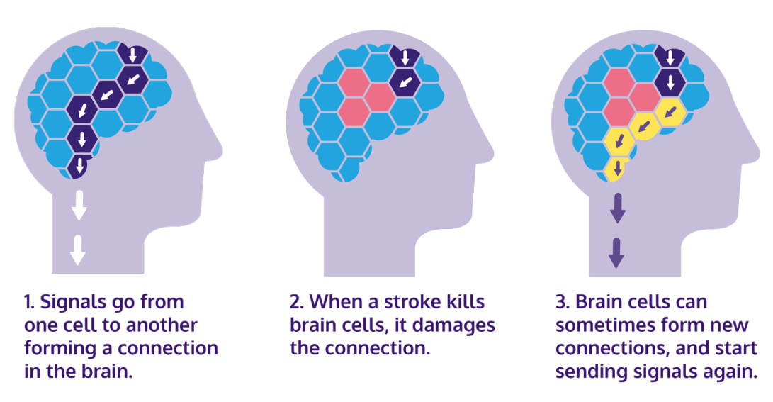
Neuroplasticity
Plasticity: brain’s ability to change by reorganizing after damage or by building new pathways based on experience.
As brain matures, certain cells take on certain functions and cannot be as readily changed.
After brain injuries, other brain areas can help compensate (e.g. ability to read Braille (touch) is associated with brain regions that handle vision).

Slide 20

Brain Technology
Bio-feedback useful in game testing/ development to assess physiological arousal.
Can pinpoint exact moment when participant has a reaction.

Slide 21
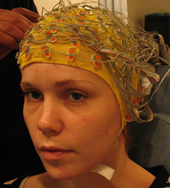
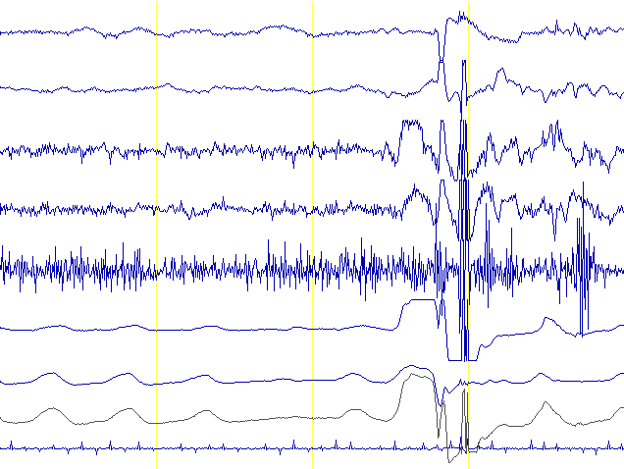
Brain Technology
Electroencephalography (EEGs)
Used to study and measure electrical activity of the brain.
One of the cheaper and more common measurement tools in game design and research.
Electrodes placed on scalp, reads electrical brain waves.
Pros: continuous measurement, detects reactions participants might not be aware of having.
Cons: causes of physiological reactions are subjective.
https://www.youtube.com/watch?v=rIbfNUA5pWk

Slide 22
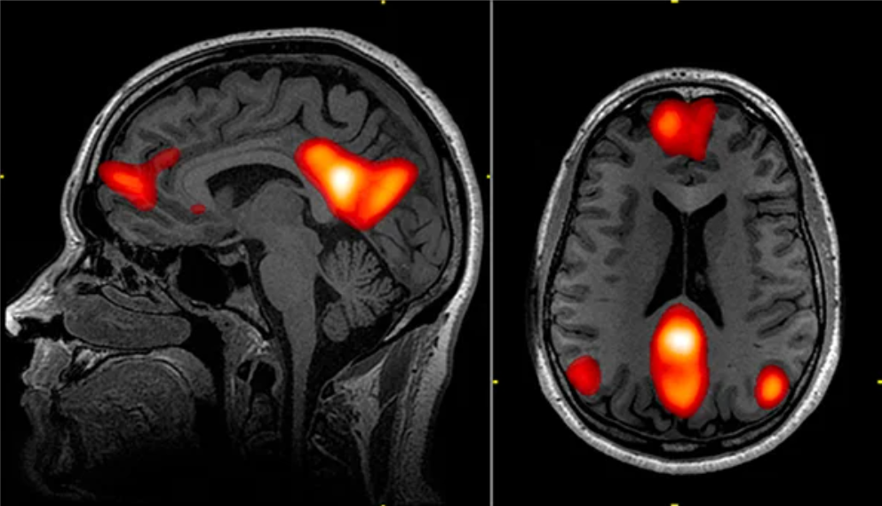
Brain Technology
Neuroimaging: fMRI
Measures increased blood flow to certain parts of the brain as a person performs different mental functions.
Pokémon study:
https://www.youtube.com/watch?v=kEIuQRHElcQ

Slide 23
Video Games & the Brain
Studies of video games and the structure and activity of our brains (Palaus et al., 2017; Chaarani et al., 2022) found links to:
Improvements in sustained or selective attention.
Improvements in memory.
Improved visuo-spatial skills (enlarged right hippocampus).
Improved hand-eye coordination.
Improved ability to shift between tasks quickly.
Structural changes in neural reward system.

